Slide 1
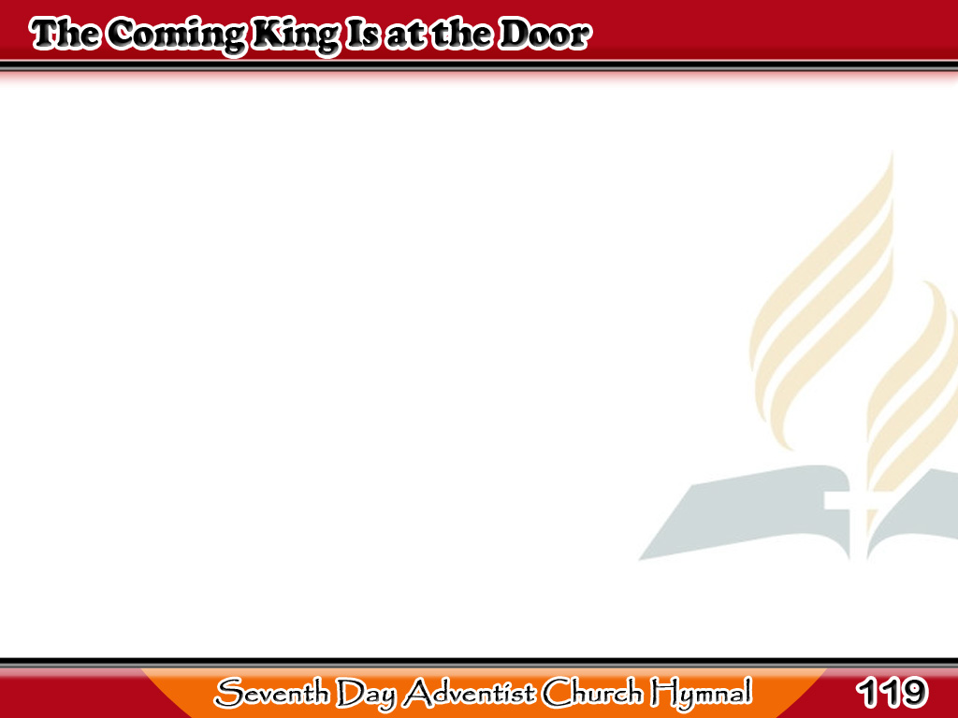
Ating Haring Paririto
The coming King is at the door,
Who once the cross
for sinners bore,
But now the righteous ones alone,
He comes to gather home.
1/4

Slide 2
Ating Haring Paririto
-Refrain-
At the door, at the door,
At the door, yes, even at the door;
He is coming, He is coming,
He is even at the door.
1/4

Slide 3
Ating Haring Paririto
The signs that show
His coming near
Are fast fulfilling year by year,
2/4

Slide 4
Ating Haring Paririto
And soon we’ll hail
the glorious dawn
Of heaven’s eternal morn.
2/4

Slide 5
Ating Haring Paririto
-Refrain-
At the door, at the door,
At the door, yes, even at the door;
He is coming, He is coming,
He is even at the door.
2/4

Slide 6
Ating Haring Paririto
Look not on earth
for strife to cease,
Look not below for joy and peace,
Until the Saviour comes again
To banish death and sin.
3/4

Slide 7
Ating Haring Paririto
-Refrain-
At the door, at the door,
At the door, yes, even at the door;
He is coming, He is coming,
He is even at the door.
3/4

Slide 8
Ating Haring Paririto
Then in the glorious
earth made new
We’ll dwell the countless
ages through;
4/4

Slide 9
Ating Haring Paririto
This mortal shall
immortal be,
And time, eternity.
4/4

Slide 10
Ating Haring Paririto
-Refrain-
At the door, at the door,
At the door, yes, even at the door;
He is coming, He is coming,
He is even at the door.
4/4

